Slide 1
Software Testing Project 2 GUI testing with Selenium
Instructor: 王凡教授
TA: 鄭大容
Email: R06943080@ntu.edu.tw

Slide 2

Selenium
a portable software testing framework for web applications
Selenium
Stable release | 2.33 / May 22, 2013
Development status | Active
Written in | Java (programming language)
Operating system | Cross-platform
Type | software testing framework for web applications
License | Apache License 2.0
Website | seleniumhq.org

Slide 3
Selenium IDE
A Firefox plug-in and is generally the most efficient way to develop test cases.
implemented as a Firefox extension
available on Chrome Store recently

Slide 4


Selenium IDE
Katalon Recorder (Selenium IDE for Chrome)
https://chrome.google.com/webstore/detail/katalon-recorder-selenium/ljdobmomdgdljniojadhoplhkpialdid
Selenium IDE
https://chrome.google.com/webstore/detail/selenium-ide/mooikfkahbdckldjjndioackbalphokd

Slide 5
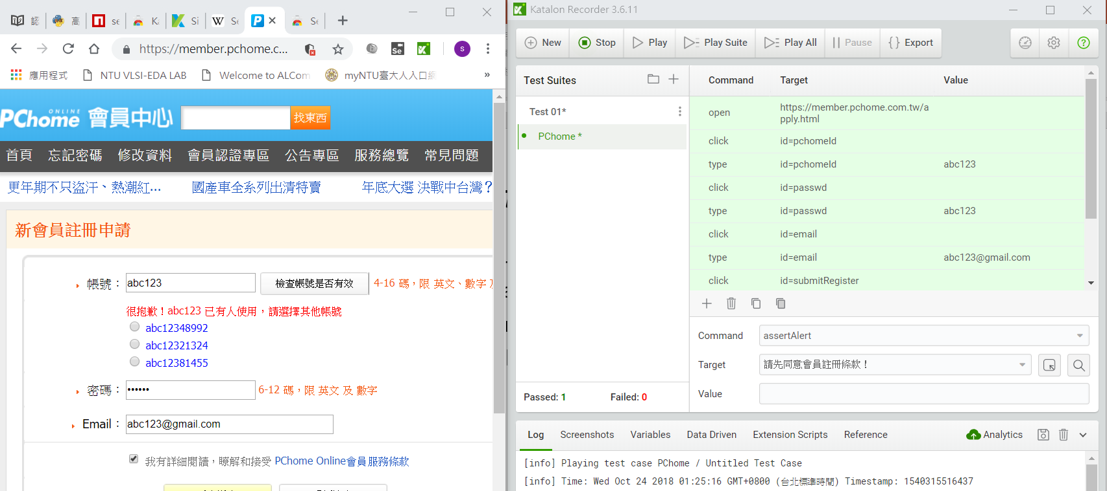
Katalon Recorder

Slide 6
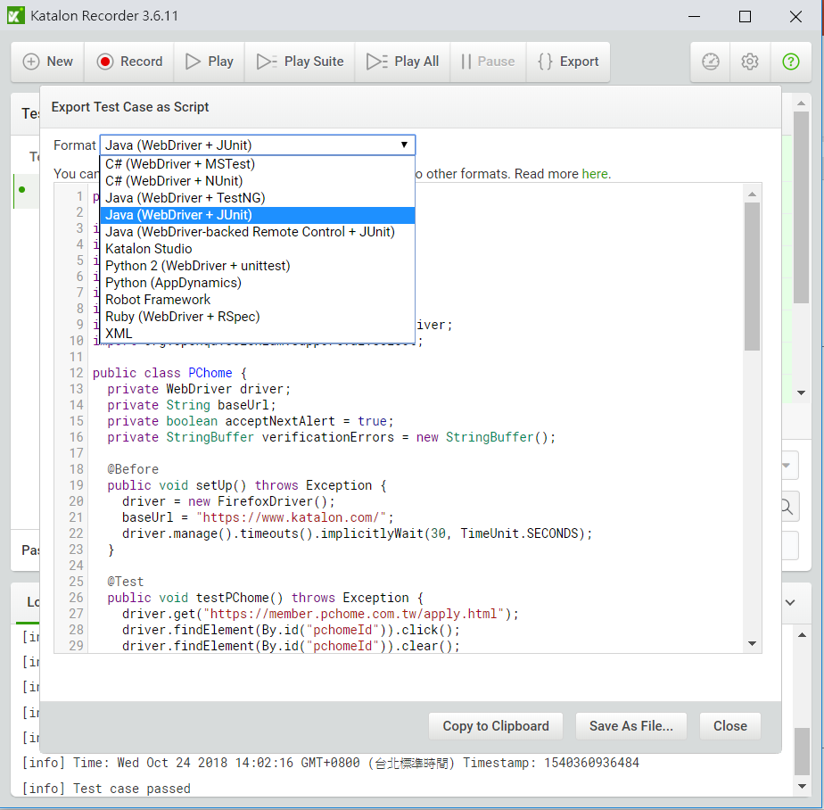
Katalon Recorder
You can write tests in Java, C#,
Ruby, and Python

Slide 7
Selenium Client API
An alternative to writing tests in Selenium, tests can be written in various programming languages.
These tests then communicate with Selenium by calling methods in the Selenium Client API

Slide 8
Unit Testing Frameworks
You can write tests in Java, C#, Ruby, and Python.
Use your favorite unit testing tools
The following uses JUnit

Slide 9
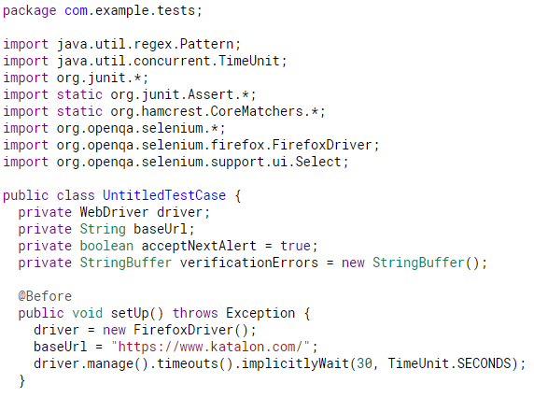
Instantiate a WebDriver
There’s also:
– ChromeDriver(),
– OperaDriver(),
– AndroidDriver(),
– InternetExplorerDriver(),
– Etc… (additional setting may needed)

Slide 10
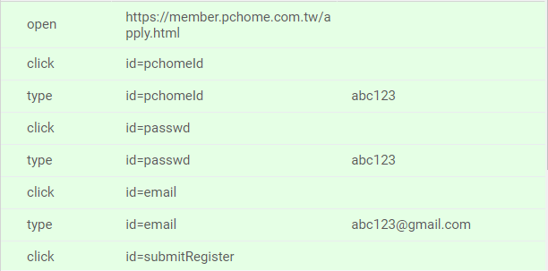
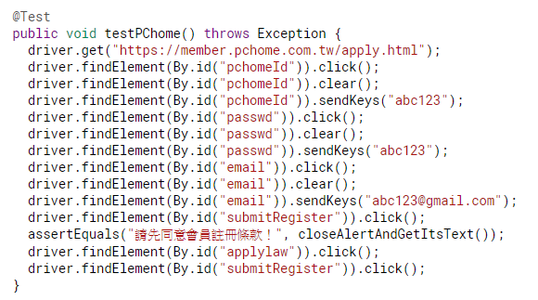
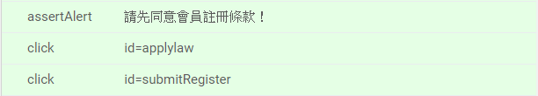
Simple Test

Slide 11
Using the findElement() method
driver.findElement(By.id("header"))
-By.name("name")
-By.tagName("a")
-By.xpath("//a[@title='logo']")
-By.cssSelector(".feautures")
-By.linkText("Blog"))
-By.partialLinkText("Ruby")
-By.className("login")
-etc…

Slide 12
Element Events
WebElement-By.name("name")
-click()
-submit()
-sendKeys()
-clear()
-isDisplayed()
-isEnabled()
-etc…

Slide 13
Requirements
SUT requirements
Test requirements
Test-cases
Implement test-cases with Selenium

Slide 14
Score
rawScore(you) = #bugs-found + line-coverage * log2(#total lines of the library SUT)
projectScore(you) = 15*rawScore(you)/(max _{anyStudent s} rawScore(s))

Slide 15
Submission
Put everything in one folder named by your student id
The folder should include:
Your source code or testsuites (in HTML format) exported from Katalon Recorder
Your report to explain what you do
rawScore calculate yourself
Compress to .zip format
Upload to Ceiba

